Slide 1
Roghanna Ábhar Subject Choice for Senior Cycle
Mí Márta 2021 patricia.uifhlaithearta @gretb.ie Comhairleoir Gairmtreoir/Guidance Counsellor

Slide 2
Clár / agenda
Miniú
To explain Matriculation – how specific subjects are required for entry to specific colleges/universities or courses
To briefly look at the points system
To give advice on how pupils can make their subject choices, including where to get information to help with those choice
Miniú ar ATG / Explain L.C.V.P.

Slide 3
Máithreánach / Matriculation
2 Rud ag teastáil chun freastal ar an Ollscoil / 2 things needed for college entry
1) Matriculation (minimum subject entry requirements)/íosmhéid ábhar
2) Points/Pointí

Slide 4
Riachtanais Mháithreánacha / Matriculation requirements
All H.E.I.s have specific entry requirements
M.sh Ollscoil na hÉireann Gaillimh NUIG– H5 in 2 Subjects/ábhar & O6/H7 in 4 subjects/ábhar Including Irish and English

Slide 5
Riachtanais Mháithreánacha / Matriculation requirements
Some courses within the H.E.I.s have more specific entry requirements
E.g. Engineering at NUIG H5 in 2 Subjects and O6/H7 in 4 subjects Including Irish and English
AND
a Science subject AND at least a H4 in higher level maths OR a pass in the special maths exam

Slide 6
Riachtanais Mháithreánacha / Matriculation requirements
If a student has achieved the minimum entry requirements (matriculated), he/she is deemed ‘qualified’ or ‘eligible’ to apply for the place.
If more people apply for places on a course than there are places, then they also need points
Note that some pupils are exempt from certain matriculation requirements

Slide 7
Riachtanais Mháithreánacha / Matriculation requirements
Tabhachtach
It is The Student’s responsibility to ensure that he/she has researched the subjects they are considering choosing.
It is The Student’s responsibility to be aware of what subjects are needed for specific Higher Education Institutes (H.E.I.s) or particular courses within those H.E.I.s.

Slide 8
Ábhar don ardteist Leaving cert subjects
Déanann daltai 7 n-ábhar don Ardteist / Students study 7 subjects for leaving Cert
ATG mar rogha / LCVP can be taken as an optional 8th subject
Déanta comhaireamh ar an 6 cinn is fear / The top 6 subjects are counted for points

Slide 9
Córas na bpointí / The points system
All subject carry equal points – except for honours maths which has a bonus 25 points if you get over 40%
Maximum leaving cert points are 625
Honours level subjects = 100 points each
Ordinary level subjects = 56 points each
If you have gained the minimum subject entry requirements for a course you have qualified for it. If more people apply for that course than there are places, then the points system is used to decide who gets the places.

Slide 10
Scála na bPointí / Points Scale
Higher level subjects are worth more points – see table below
30% at higher level is a pass and worth 37 points
40% at ordinary level is a pass and worth 12 points
Revised LCVP Points
Distinction 66
Merit 46
Pass 28
Honours Maths
+25 Bonus Points for grade H6 and higher

Slide 11
Páirt 3 / Part 3:
Cen chaoi le haghaidh ábhar a roghnú ?
How to choose subjects?

Slide 12
Ná h-Ábhair roghnach / the Subject options
3 Ábhar Éiginnteach / 3 CORE SUBJECTS​ -
Béarla / English​
Gaeilge / Irish​
Mata / Maths ​
+​
Teanga Iasachta / Modern Language
+ 3 Ábhar Roghnach / 3 OPTIONS out of 18 possible subjects

Slide 13
Ag roghnú ábhair / Choosing subjects
Cur an ceist seo / All students should ask themselves 3 questions
What subjects do I need to get into my preferred college course(s)?
What subjects do I enjoy?
What subjects will I do well at?

Slide 14
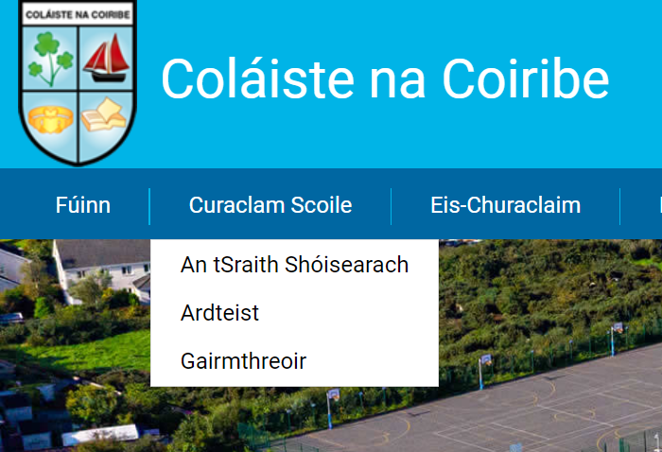
Eolas ar fáil / information available
Suíomh Idirlín / Websites:
www.qualifax.ie
www.careersportal.ie
Suíomh na Scoile / School Website
“Gairmtreoir”

Slide 15
www.qualifax.ie
Bunachar SionraíNaisiúnta / The National Courses Database.
Dhá Ailt / It has two sections relevant to subject choice – Leaving Cert. Subject Choice and Search Courses
Leaving Cert. Subject Choice - shows you the full list of courses, within the CAO system, which require a specific Leaving Certificate subject, including the grade and level required.
Search Courses – The C.A.O. section has information on every 3rd level course in Ireland including the minimum subject entry requirements

Slide 16
Gairm-bheatha & na h-ábhair / Careers & Options: Careers Portal.ie

Slide 17
Ról na dtuistí / Parental role
Parents are the biggest influence on secondary school students’ decisions. Discuss the subject choice options with your son/daughter and help them with the research if asked
But do not do ALL the research!

Slide 18
Coiméad do roghanna oscailte / keep your options open
Má tá suim agat…
If a student is interested in a career in the
ENGINEERING,
MEDICAL,
PARAMEDICAL,
SCIENCE or COMPUTERS
at UNIVERSITY, they may need to pass at least 1 laboratory science subject.

Slide 19
Coiméad do roghanna oscailte / keep your options open
Bíonn gá le teangacha iasachta do chursaí áirithe / Many courses require a continental language
Arts, Commerce, Law, Medicine and Biotechnology amongst others at NUIG

Slide 20
Coinnigh do roghanna oscailte / keep your options open
Déan cinnte / make sure !!!
Therefore, one way of keeping MOST 3rd level options open is to choose a science subject and a 3rd language with Irish, English and Maths
There is no point in choosing a subject he/she does not like if your son/daughter is certain he/she has no interest in these options.

Slide 21
a.t.g.o / l.c.v.p
The L.C.V.P. is something EXTRA, added to the leaving Cert. It does not dilute it in any way. It is like an extra subject.
Chun an ábhar seo a dhéanamh / To qualify for the L.C.V.P.
You must be studying specific subject groupings to be eligible to study LCVP. These can be seen at
http://lcvp.slss.ie

Slide 22
Chun A.T.G a dhéanamh, tá na hábhair seo uait / Subject requirements to do l.c.v.p
Construction Studies; Engineering; Design and Communication Graphics; Technology - Any Two 2 Physics and Construction Studies or Engineering or Technology or Design & Communication Graphics 3 Agricultural Science and Construction Studies or Engineering or Technology or Design & Communication Graphics 4 Agricultural Science and Chemistry or Physics or Physics/Chemistry 5 Home Economics; Agricultural Science; Biology - Any Two 6 Home Economics and Art - Design Option or Craft Option 7 Accounting; Business; Economics - Any two 8 Physics and Chemistry 9 Biology and Chemistry or Physics or Physics/Chemistry 10 Biology and Agricultural Science 11 Art - Design Option or Craft Option and Design & Communication Graphics
Services Groupings
12 Engineering or Technology or Construction Studies or Design & Communication Graphics and Accounting or Business orEconomics 13 Home Economics and Accounting or Business or Economics 14 Agricultural Science and Accounting or Business or Economics 15 Art Design or Craftwork Option and Accounting or Business or Economics 16 Music and Accounting or Business or Economics

Slide 23
Conas a dhéantar measúnú at ATG / How is it examined?
60% of the marks are given for a portfolio of your work/Tionscnámh
40% of the marks are for a written exam in May of your Leaving Cert. Year./Scrudú scríofa

Slide 24
ATG / LCVP
Marcanna sa scrudú
L.C.V.P. can be included as one of your 6 subjects for points for college entry.
DISTINCTION 66 Points
MERIT 46 Points
PASS 28 Points
It cannot be used to matriculate

Slide 25
A.T.g / l.C.V.P
Who should study L.C.V.P.?
Buntáistí
L.C.V.P. is beneficial for anyone who has 5 or less higher-level subjects. A distinction is worth the same in terms of points as a H4 on a higher-level paper. Therefore it can be very useful for gaining valuable points.

Slide 26
A.T.G / L.C.V.P
Má tá tú ag déanamh níos lú ná
If you are doing 6 or 7 higher level subjects, it is unlikely you will use it as one of your best 6 subjects for points.
However there are many other skills which students gain from this programme.

Slide 27
Cúrsa 2 Bhliain / 2 Year Course
Cúrsa 2 Bl / 2 Year Course
2.5 Hours / Scrudú in early May
Léamh / Notaí / Paipéar scrúdaithe

Slide 28
Na Roghanna / the options (Based on demand)
Teanga Iasachta / Modern Foreign Language | Eolaíocht / Science | Ábhair Practiciúla / Practical Subjects | Artistic and Creative | Sóisialta / Social | Gnó / Business
Fráincís / French | Bitheolaiocht / Biology | Foirgníoch / Construction Studies | Ealaíon / Art | Tíreolas / Geography | Staidéar Gnó / Business Studies
Spáinis/ Spanish | Fisic / Physics | Design and Communication Graphics | Ceol / Music | Stair / History | Cúntasaíocht / Accounting
 | Ceimic / Chemistry | Teicneolaíocht / Technology |  | Eacnamaíocht Bhaile / Home Economics | Eacnamaíocht / Economics
 | Eolaiocht Talamhaíochta / Agricultural Science (Nua/New)
 | Mata Feidhmeach / Applied Maths

Slide 29
Teangacha Iasachta / Modern foreign language
Fráincís / French
Spáinis / Spanish
Roghnóidh daltaí an teanga rinne said don T.S / Students will choose the language they studied for Junior Cert
Teangacha eile: if a student is fluent in another language, for example Polish – it is possible to study this outside of school and take the leaving cert exam in it

Slide 30
Ábhair Eolaíochta / Science subjects
Ábhar Eolaíochta amháin ag teastáil / One science subject is essential for: the following careers
Science | Technology | Nursing | Home Economics
Radiography | Physiotherapy | Occupational Therapy | Speech and Language Therapy
Nutrition | Podiatry | Engineering | Agriculture
Computers and IT | Environmental Science | Medical Science | Architecture
PE Teaching | Design and Manufacture
*Veterinary | *Medicine | *Dentistry | *Pharmacy

Slide 31
Ceimic / Chemistry
Tá Ceimic ag teastáil / Chemistry is required for ​
Human Nutrition and Biomed Science DIT
Dentistry​
Dietician​
Pharmacy​
Veterinary Medicine​
Medicine - in some colleges​ there are specific subject combinations – in all colleges if you enter with 2 science subjects you can qualify in 5 years instead of 6

Slide 32
Bitheolaíocht / Biology
Tá Bitheolaiocht ag teastáil / Requirement for
Genetics course at UCC
Human Health and Disease at Trinity​
Home Economics with Biology in St Angelas
Health Science in LYIT
Desirable for courses in Nursing, Veterinary, Medicine, Pharmacy, Nutrition, Beauty Therapy​

Slide 33
Fisic / Physics
Tá Fisic ag teastáil / Required for
Theoretical Physics in Trinity
Very relevant and desirable subject in Engineering and Computers/Software but not necessary as an entry subject​
What kind of student would Physics suit?
Students who wonder why and ask how
Students who are interested in the following careers would be advised to study Physics: Electrician, Optician, Doctor, Dentist, Engineer, Computer Technician and Programmer.

Slide 34
Ábhar nua: Eolaíocht talamhaíochta / Agricultural science
4 Chuid / 4 Parts:
1. Scientific practice 2. Soils 3. Crops 4. Animals
Turgnaimh / Experiments:
Individual Investigative Study:
Worth 25%, 2,500 words, a new thematic brief is released every second year. This year's topic is sustainabilty.
Students must carry out their own individual experiment(s) and do research on the topic.
Scrúdú Scríofa / Written Exam:
Worth 75%

Slide 35
Ábhair Practiciúla
Design and communication graphics (DCG): (Continuation of Technical Graphics​)
60% TG board drawing exam​
40% Practical Project completed on computer​
Foirgníocht / Construction studies: Continuation of Materials Technology (Woodwork)
50% exam​
25% Day Project​
25% Practical Project​
Teicneolaíocht / Technology:
50% exam​
25% Project​

Slide 36
Foirgníocht / Construction studies
Continuation of Materials Technology (Woodwork) ​
50% exam​
25% Day Project​
25% Practical Project​
Useful, not necessary for careers in Construction​
Apprenticeships, Electrician, Quantity Surveyor, Civil Engineering, Teaching
What kind of Student would Construction Studies suit
It is recommended that a student taking Leaving Certificate Construction Studies has a general interest in buildings and the built environment.
Each student should have an aptitude for, and an interest in design and practical work.

Slide 37
Gnó, Eacnamaíocht, Cúntasaíocht / Business grouping
Cúntasaíocht / Accountancy​
Accounting H4 is an entry requirement onto the Bachelor of Commerce with Accounting from NUI Galway. Compórdach le Mata freisin/ comfortable with Maths advisable)
Gnó / Business Studies​
It is possible to do Business at third level without having studied Business to Leaving Certificate.
Eacnamaíocht / Economics​
It's also possible to study Economics at third level without having studied to leaving certificate although students who have taken Economics for their Leaving Certificate have a distinct advantage over students who have not. Careers in the Central Bank, Finance, Insurance, Economist and Consulting and Management

Slide 38
Stair & Tíreolaíocht / History and geography
An éileamh ar na h-ábhair seo / Hugely popular subjects​
20% of exam project based in both subjects​
Ideal for Students who have strong English language skills and are able to write.
Students aiming to improve their self-discipline and research skills.

Slide 39
Eacnamaíocht Bhaile / Home economics
20% Dialann / Journal (project based)
Níos lú cócaireacht ná ag an T.S / Less focus on cooking than at Junior Cycle
​Practical cookery assessed through written exams only
Textile Electives—fashion design, social studies, home design and management
Much of the course is theory based
Suim san ábhar ag teastáil / Strong interest subject​ required

Slide 40
Na h-Ábhair cruthaitheacha / Creative Subjects
Ceol / Music:
50% Practical Exam
50% Written paper
Practical exam (Easter 6th Year) Practical can be Performance only or Performance with Music Technology​
Play an instrument or Sing​ or both
Labhair le do mhúinteoir / Speak with your teacher!!
Ealaín / Art :
Practical Assignments: 62% of mark
Art History Theory: 38% of mark
Requirement for Art college courses and where portfolios are required​
Useful subject in Architecture as portfolio required​
​

Slide 41
a.t.g / l.c.v.p
The L.C.V.P. is something EXTRA, added to the leaving Cert. It does not dilute it in any way. It is like an extra subject.
You will be studying 2 ‘Link Modules,’ Preparation for the World of Work and Enterprise Education
60% of the marks are given for a portfolio of your work/Tionscnámh
40% of the marks are for a written exam in May of your Leaving Cert. Year./ Scrudú scríofa

Slide 42
Cad atá le déanamh agat / What you have to do
Ná h-Ábhair roghnach a phiocadh / Choosing the optional subjects
Pioc na rogha teanga mar uimhir 1 (First pick must be your language)
Pioc 2,3,4,5,6, (ag tosnú leis an gceann is fearr leo / Pick 2,3,4,5,6, (starting with the option they like most)
Sonraí logáila Vsware / Vsware Log-in Details
Beidh tú ag roghnú na h-ábhair anseo ar VSware / You will be choosing the subjects in Vsware Subject Options

Slide 43
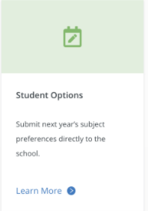
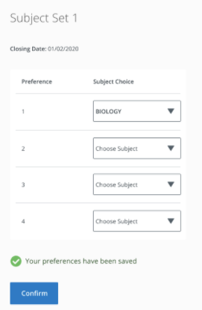
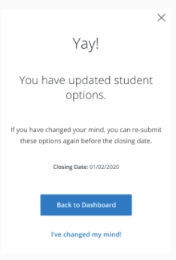
Parent dashboard / Your Student / click 'learn more' under Student Options
Ábhar 1 /Option 1 = Teanga / Language
Ábhar 2 / Option 2 = Do Chead rogha / 1st Choice 2,3,4,5,6

Slide 44
Ábhar machnaimh / considerations to think about
Fág do roghanna leathan agus oscailte / Leave your opens open. Taking English, Irish, Math’s, a Language, and any 3 optional subjects will keep yours options open for careers and courses! (if unsure – keep options open with a Science subject!)
Ná bí buartha faoi leibhéal / Assess the level you will study at Hons or Ordinary further down the road​
Déan pé rud é atá agam aige / Play to your strengths – what are you good at?

Slide 45
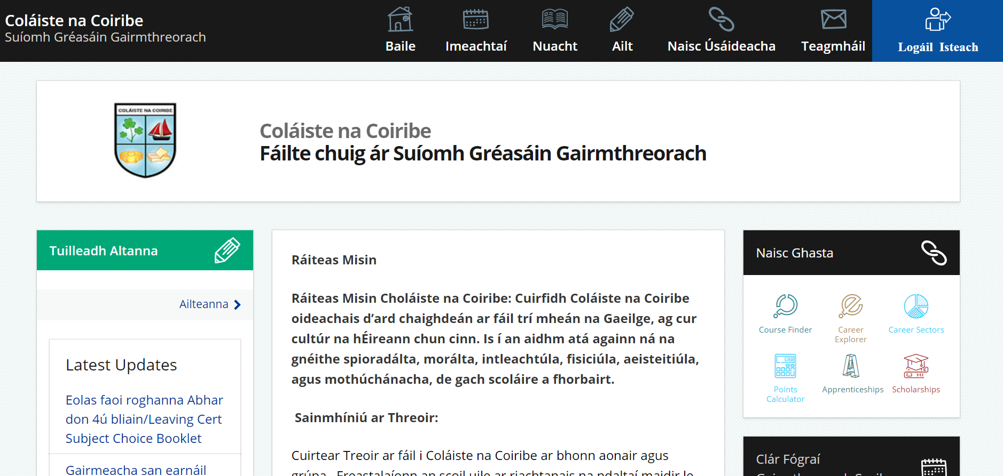
Slán & go raibh maith agaibh
Má tá ceisteanna agaibh / If you have questions
Eolas anseo / information available here:
www.qualifax.ie​
www.careersportal.ie​
www.cao.ie
patricia.uifhlaithearta@gretb.ie

Slide 46
Choosing a Modern foreign language
A Modern Foreign Language (MFL) is essential for some courses in NUI Universities (Galway, Cork, Dublin, Maynooth)​
MFL is not required for courses in science, engineering, agriculture or nursing in these colleges​
Required for Cadets in Army and Air Corps
MFL is not required to study most courses in an IT like GMIT for example​ or UL, Trinity or DCU
People with a language as part of their degree are highly employable; Multi- cultural society, a foreign language is an added advantage​​
Useful for Tourism – Hotel and Catering and International Business​

Slide 47
Think about your top 5…
After Maths, English & Irish
Students are requested to choose their top five subjects in order of preference​
We will endeavour to grant them their top 4 options but cannot guarantee this due to timetabling and resourcing

Slide 48
Options Science
Biology
Physics
Chemistry
Physchem
Agricultural Science
Computer Science
Applied Maths

Slide 49
physchem
8 topics from the physics curriculum and 8 topics from the chemistry curriculum
These topics are not assessed at same higher-level physics or chemistry standard
It is not possible to study physics and physchem
What kind of Student would Physics and Chemistry suit?
Anyone considering a career in a scientific discipline, such as physics, chemistry, environmental science, or medicine.
Students who have an interest in both physics and chemistry, but don't have enough time to commit to both subjects separately. Biology students may fall into this category.

Slide 50
Computer Science – New subject
Examination 70%
Coursework assessment 30%
The fundamentals of computer technologies and their potential applications.
Understanding how computers work and how they can be used to address problems and design solutions.
How to read, write, test and modify computer programs.
How computers work and how their component parts interrelate.
The ethical, social and environmental role of information technology, in today's world as well as the past and the future.

Slide 51
Applied maths
Supports students studying Physics and/or H.L. Math's ​
Very useful but not required for Engineering courses​
What kind of student might Applied Math's suit?
This subject comes highly recommended for students considering a career in any area of Engineering, Science, Information Technology, Business, Finance, Architecture or Education.
Modules include: Constant Acceleration, Relative Velocity, Projectiles, Work Energy and Power, Differential Equations and Newton’s Law

Slide 52
Options Practical Subjects
Construction Studies
Design Communication Graphics
Engineering

Slide 53
Engineering
A continuation from Metalwork ​
50% Exam ​
25% Day Project ​
25%Project​
Useful for engineering careers, apprenticeships and construction​
If you have had an aptitude for this subject, good idea to carry on with it.​
Physics and Maths most important subjects for a career in engineering.

Slide 54
Options Artistic and Creative
Art
Music

Slide 55
Ceol / music
50% Practical Exam
50% Written paper
Practical exam (Easter 6th Year) Practical can be Performance only or Performance with Music Technology​
Play an instrument or Sing​ or both
Written exam
Students will learn about music theory
You can take it up for 5th year if you have music knowledge (i.e. be able to read treble and bass clef) ​
Talk to music teachers for advice

Slide 56
options Social
History
Geography
Politics and Society
Home Economics
Physical Education
Religious Education

Slide 57
Politics and society
Report on a citizenship project (20% )​
Written examination (80% )​
Human rights, equality, diversity, sustainable development, power and democratic decision-making.
Studying Politics & Society gives students a real insight into people, power and how society works
Useful for Journalism – Politics- Media – Teaching but not a requirement

Slide 58
Physical Education – new subject
Written Exam - 50%
Project - 20%
Performance - 30%
Written examination
Factors which affect participation and performance including a case study requiring students to apply their learning to a physical activity
Physical activity project
As performer or coach/choreographer students will analyse and set 4 performance goals and plan, implement and reflect on them
Performance assessment, worth 30% with common format for both higher and ordinary level.
Students complete a structured performance video in a chosen activity

Slide 59
Religious education
Coursework 20%​
Terminal written paper 80%
Promotes tolerance and mutual understanding​
It is a broad course which seeks to develop the skills needed to engage in meaningful dialogue with those of other or of no religious traditions​

Slide 60
Options Business
Business Studies
Accounting
Economics
LCVP

Slide 61
LCVP
Leaving Certificate Vocational Programme
This is an optional extra subject that students will be offered if they qualify for it - Qualifying categories are on the next slide
If a student takes LCVP they may get more points in this subject than in one of their other 6 and so this will be used for points
LCVP is made up of practical business ‘type’ assignments that should be completed during class time – 1 hour per week. So it doesn’t take time away from study – and so can prove to be easier points to acquire​
60% - Portfolio – Which is made up of a CV, Action Plan, Career Investigation, Summary Report, Work Experience, plus 2 options​
40% - Examination in May
Distinction – 66 points​ Merit – 46 points​ Pass – 28 points​

